Slide 1
Indexing
CS 400/600 – Data Structures

Slide 2


Memory and Disk
Typical memory access: 30 – 60 ns
Typical disk access: 3-9 ms
Difference: 100,000 to 1,000,000 × !
Over the past 10 years:
  CPU speeds increased 30× (100 MHz to ~3GHz)
  Disk speeds increased ~2×
  Disk sizes increased ~80x
  Disk speed relative to the amount of data stored has gotten much lower

Slide 3
Disk Organization
As programmers, we see a logical file. It appears as a contiguous sequence of bytes.
In reality, the corresponding physical file might be spread all over the disk.
The file manager (part of the O/S) takes requests for logical files, accesses the corresponding physical files, and feeds the information to your program

Slide 4
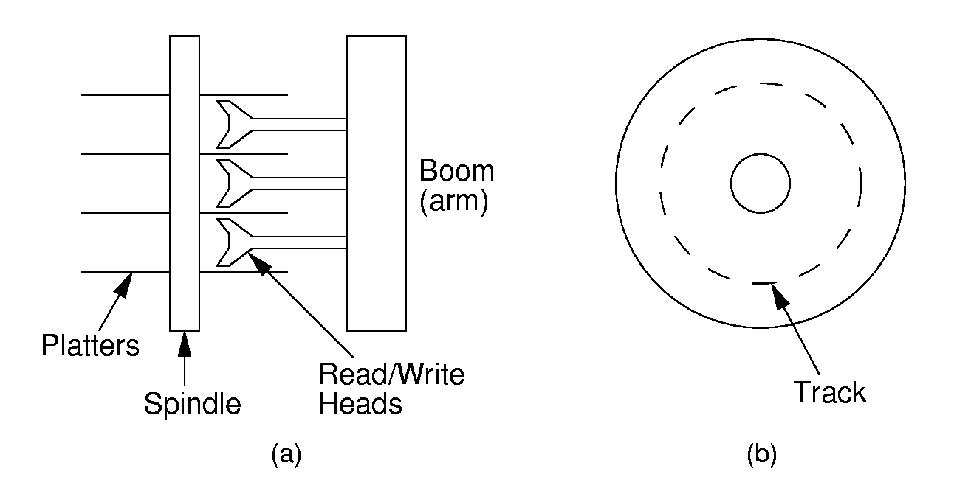
Disk Architecture
All the corresponding tracks on each platter are collectively called a cylinder, and are accessed at the same time.

Slide 5
Constant Rotational Speed
The smallest unit of I/O is a sector
The disk spins at a constant speed, unlike a CD-ROM

Slide 6
Sector Interleaving
Interleaving factor = 3
After reading a sector, it takes time to process the data. Meanwhile, the disk is still rotating.
The next sector is not stored immediately following the current sector, so that it will be approaching the head after the processing completes

Slide 7
Performing a Disk Read
Seek time: time to move
head to the right cylinder
Rotational latency: time
for the correct sector to
rotate under the head
(3600, 5400, 7200 RPM)
Transfer time: time to read a sector of data
By far, the highest cost is the seek time

Slide 8
Clusters
Most operating systems don’t allow you allocate a single sector for a file
The smallest unit of file allocation is a cluster
A cluster is a group of consecutive sectors

Slide 9
Seek Times Revisited
Disk manufacturers usually specify two kinds of seek times:
  Moving from one track to the next track: track-to-track cost
  Average seek time for a random access: average seek time
With interleaving, it may take several rotations to read a full track of data!

Slide 10
Access Time Example
16.8 GB disk with 10 platters
13,085 tracks per platter
256 sectors per track, with 512 bytes per sector
Track-to-track seek: 2.2 ms
Average seek: 9.5 ms
Interleaving factor: 3
O/S specs
  Cluster size = 8 sectors (4KB) = 32 clusters/track

Slide 11
Access Time Example (2)
5400 RPM = 11.1 ms per rotation
  It takes 3 rotations to read a full track (32 clusters)
Suppose we want to read a 1MB file
  1MB ÷ 4KB (per cluster) = 256 clusters
The performance depends on how the physical file is stored on the disk…

Slide 12
Contiguous Track Access
Suppose the file is stored entirely on contiguous tracks…
  Initial track:
    Seek to initial track: 9.5 ms
    Rotate to start sector (on average ½ a rotation): 11.1/2 ms
    Three rotations to read track: 3 × 11.1 ms
    Total: 48.4 ms
  Subsequent 7 tracks need only a track-to-track seek:
    2.2 ms + 11.1/2 ms + 3 × 11.1 ms = 41.1 ms
  Total: 48.4 ms + 7 × 41.1 ms = 335.7 ms

Slide 13
Random Track Access
Suppose the clusters are spread randomly over the disk
  To read one cluster (8 sectors out of 256 per track) would require 8/256 of a rotation if they were consecutive sectors
    With an interleaving factor of 3, the section of the track that the 8 clusters occupy is 3 times as long, so we need (3×8)/256 of a rotation to read a cluster ≈ 1 ms
  Total time is: 256 × (9.5 + 11.1/2 + (3×8)/256 × 11.1ms) = 3877 ms
  Almost 4 sec vs. about 1/3 of a second

Slide 14
Locality and Buffers
The O/S often maintains a buffer pool that acts as a cache for the disk
When a sector is read, subsequent sectors are cached in memory in buffers
Reading subsequent buffers if fast
The principle of locality ensures that we will often access the buffered data

Slide 15
Rule of Thumb
When processing data stored on disk:
Minimize the number of disk accesses
If you must read from the disk, try to read from consecutive sectors.

Slide 16
Database Organization
Primary Key – a unique key for each record, like employee ID
  Often inconvenient for searching
Secondary key(s) – non-unique indices, more convenient for search
Common types of queries:
  Simple select
  Range query
  Sort – visit all records in key-sorted order

Slide 17
Memory Indexes
When data are small enough, indexes can be stored in memory
7
4
6
1
2
3

Slide 18
Linear Indexing
If the indexes won’t fit in memory, tree indexing is difficult, because random access is required.
Linear files with key/pointer pairs
  Sorted by key, so we can use binary search
  Pointer to the disk location, or to the primary key

Slide 19
Linear Indexing (2)
If the index is large, binary search again requires random access
A two level index can be used to show which disk clusters contain each chunk of the primary linear index
Problems: 1) Updates are expensive.
2) Duplicate secondary key values waste space. Each value is stored in the index.

Slide 20
Other linear indices
2-D linear index:
Inverted list:
Jones
AA10
AB12
AB39
FF37
Smith
AX33
AX35
ZX45
Zukowski
ZQ99
Jones
0
0
AA10
4
Smith
1
1
AX33
6
Zukowski
3
2
ZX45
3
ZQ99
4
AB12
5
5
AB39
7
6
AX35
2
7
FF37

Slide 21
Problems with linear indexing
Updates are expensive – a single update can require changing the position of every key in the index
Inverted lists help, but insertion of new secondary key values is still expensive
  Ok when there are few secondary keys and lots of duplication
Can we break the linear index into blocks so that updates will only require changing a single disk block?

Slide 22
ISAM
Records are stored in primary key order on disk
Memory table stores lowest key of each cylinder
Cylinder index stores lowest key of each block
IBM, 1960’s
Cylinder keys
(memory)
Cylinder 1
Cylinder 2
Cylinder
index
Cylinder
index
Records
Records
Overflow
Overflow
System
Overflow
Note the level of O/S control required.

Slide 23
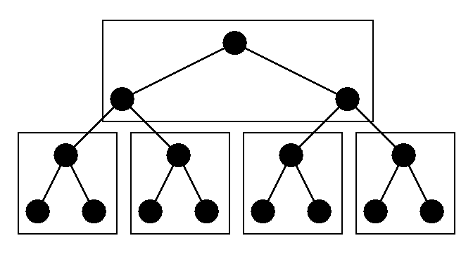
Tree Indexing
In order to store an index in a tree:
  Subtrees should be in the same disk block
  The tree should be height balanced (like an AVL) tree to prevent many disk accesses
  Balancing should not require many random disk accesses
2-3 Trees → B-Trees → B+ Trees

Slide 24
2-3 Trees
A 2-3 tree is a BST, with the following properties:
  Each node contains either one or two keys
  Every internal node has either two children and one key, or three children and two keys
  All leaves in the tree are at the same level

Slide 25
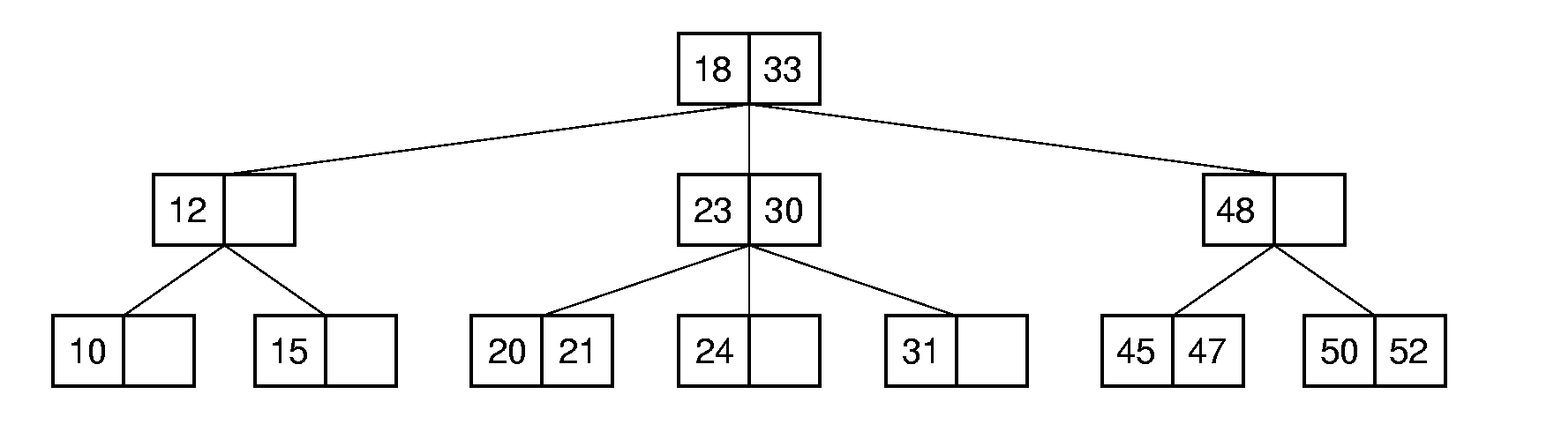
2-3 tree search
Similar to BST, but with more keys (sometimes):

Slide 26
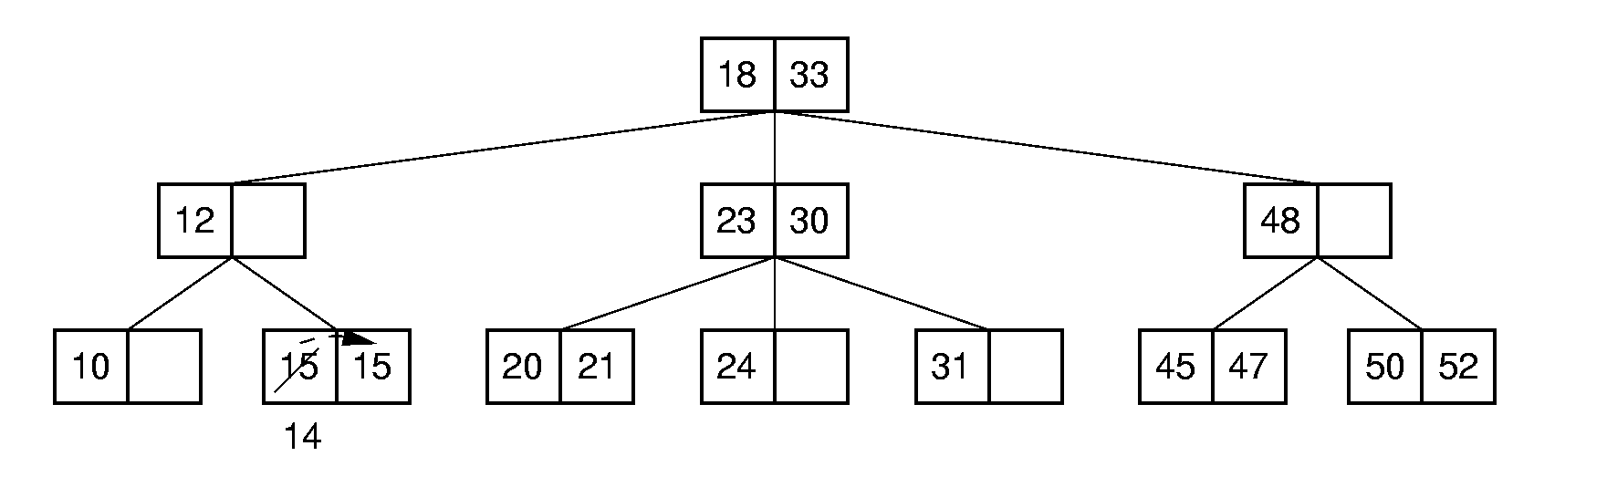
2-3 Tree Insert
Like a BST, we find a leaf node for insertion
Case 1: Only one key -- simple

Slide 27
2-3 Insert (2)
Case 2: The leaf node is full – node split
  Create new node for the largest of the 3 keys
    Original node L, gets smallest new node L´ gets largest
    Pass the middle key and a pointer to L´ to the parent
    If there is room, the middle key becomes the rightmost key of the parent, and the pointer to L´ becomes the rightmost pointer of the parent
    Otherwise, split and promote again

Slide 28
2-3 Insert (3)
Insert 55

Slide 29
2-3 Cascading Insert
Insert 19

Slide 30
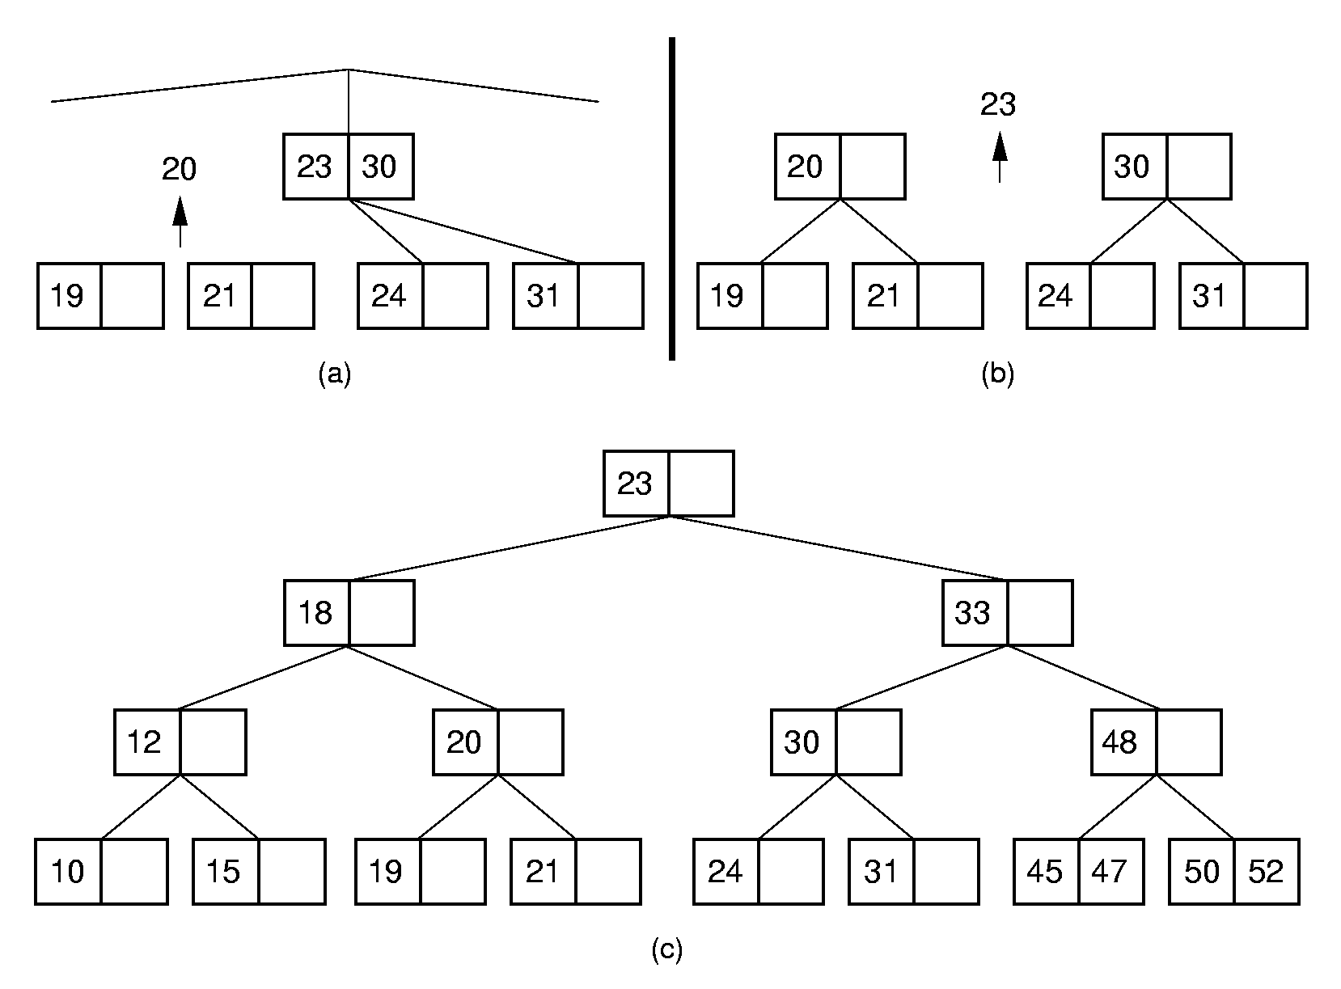
2-3 Cascading Insert (2)

Slide 31
2-3 Tree Delete
2-3 Tree delete is similar to a BST delete, but is very complex
  Delete from a leaf node is easy
  When deleting from an internal node, we can replace the key with a similar key from a subtree, much like a BST delete
  If the subtree is sparse, there may be no node with a similar key that can be removed and maintain at least one key per node
    In this case, you must merge nodes together

Slide 32
B-Tree
R. Bayer and E. McCreight, 1972
By 1979, the standard file organization for applications requiring insertion, deletion, and key-range searches
The 2-3 tree is a B-tree of order 3
  That is, the B-tree is a generalization of the 2-3 tree

Slide 33
B-Tree Properties
Always height-balanced, with all leaves at the same level
Update and search affect only a few disk blocks
Related keys are stored in the same disk block
  Locality of reference is good
Guarantee that every node is full to a minimum percentage

Slide 34
B-Tree Order
For a B-Tree of order m
  The root is either a leaf or has at least 2 children
  Each internal node has between ⎡m/2⎤ and m children
  A leaves are on the same level of the tree
M is chosen so that a node fills a disk block
  Often 100 or more children!

Slide 35
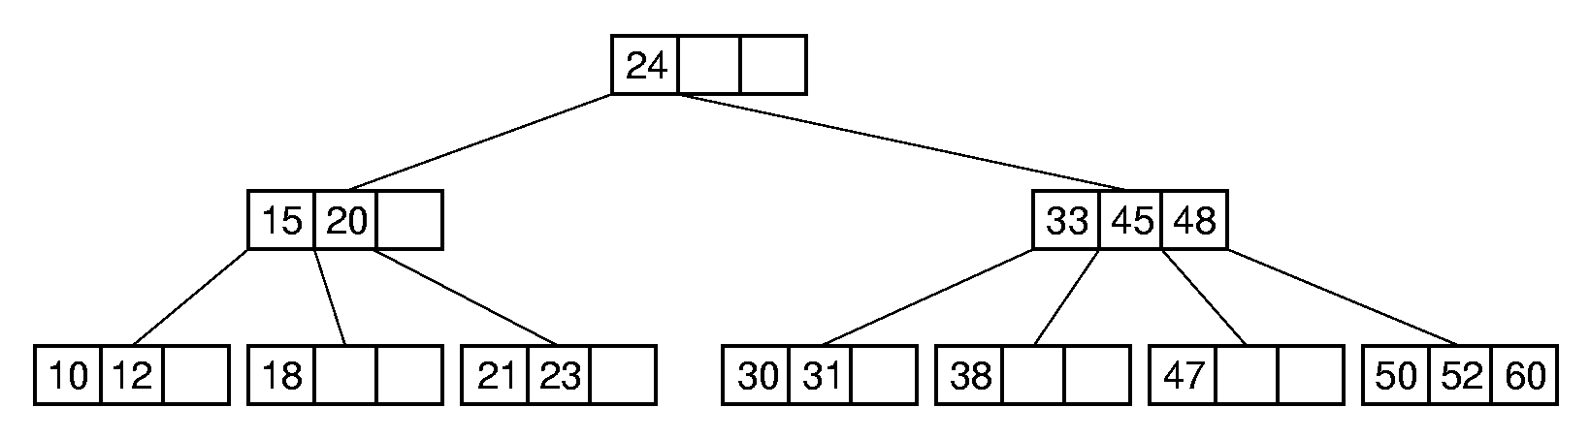
B-Tree Search
Perform binary search on the keys in the current node. If key not found, follow correct pointer and repeat.
A B-tree of order four

Slide 36
B-tree insert
Similar to 2-3 tree insert
Find a leaf node
  If there is room insert
  If not, split and promote the middle key to the parent
  If the parent is full, repeat
Guarantees that leaf nodes will always be at least ½ full.

Slide 37
B⁺ Trees
Stores records or pointers only at the leaf nodes
  Leaf nodes may store more or less than m records, depending on the relationship between record size and pointer size
  Leaf nodes must remain half full
Internal nodes have only key values
Leaf nodes are linked in a doubly linked list
  Makes range queries very easy!

Slide 38
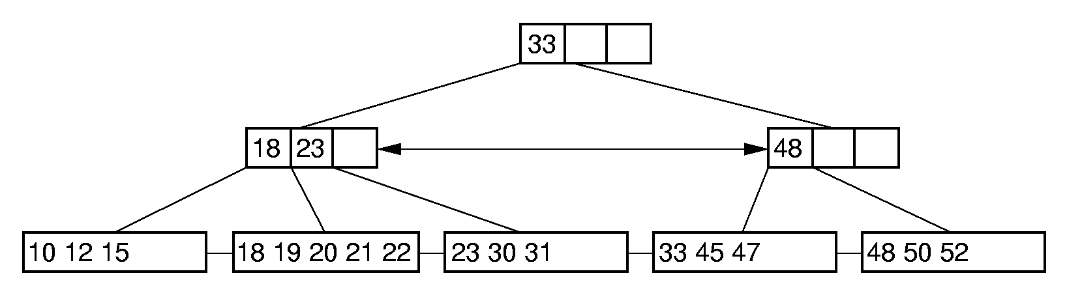
B⁺ Tree Search
Search for 33 progress all the way down to the proper leaf node…

Slide 39
B⁺ Tree Delete
If deletion causes underflow, borrow from a neighboring node, if possible
Note the changed index value

Slide 40
B⁺ Tree Delete
If neither sibling can donate, then the node gives its nodes to a sibling and is deleted
There must be room because the node is less than half full and the sibling is at most half full

Slide 41
B⁺ Tree Delete
This node now has only one child, so we borrow from the left subtree of the root

Slide 42
B* Tree
The B⁺ tree is always at least ½ full
The B* tree is a variant with different merge/split rules that is always at least 2/3 full.

Slide 43
B-Tree analysis
Search, insert and delete are Θ(log n), where n is the number of records in the tree.
However, the base of the log is the branching factor, which is generally very high (often 100 or more), so the trees are very shallow and these operations are very efficient.
To minimize disk access, the upper levels of the tree are often kept in memory, and blocks are stored in memory buffers

Slide 44
Size Analysis
Consider a B⁺ tree of order 100 with leaf nodes containing 100 records
  One level tree: 50 to 100 records
    Root is a leaf
  Two level tree: 100 to 10,000 records
    Two leaves with 50 records to 100 leaves with 100 records each
  Three level tree: 5000 to 1 million records
    Two second-level nodes with 50 children containing 50 records each, to 100 with 100 full children each
  Four level tree: 250,000 to 100 million records

